Slide 1
Automated crop Pests and Disease Detection using Deep Learning Techniques
By-
Jinendra Gambhir (2018080835)
Naveen Patel (2018080837)
Prathamesh Takale (2017068033)
Shrinivas Patil (2017068677)
Guidance of-
Dr. A.M.Chougule
(Associate Professor)

Slide 2
Introduction
Diseases and pests in plants cause major production and economic losses in agricultural industry.
Average 21% of the crop yield is lost due
to outbreak of Pests and Diseases.
Annual monetary loss in India is
Rs.60,000 crores.

Slide 3
Insects and diseases are the two main biological factors for losing crop yield and causing economic loss to farmers.
Important agricultural crops are threatened
by a wide variety of plant disease
and pests.

Slide 4
Damage to crops due to pest and disease infestation accounts 40% of total agriculture production.
Due to lack of right diagnosis at right time expected pest/disease control is not achieved leading to monetary loss as well as environmental pollution due to improper and excess use of agrochemical.
However, crop losses can be minimized, and specific treatment can be tailored to combat specific pathogens if plant diseases are correctly diagnosed and identified early
This can be reached by using automation method for early diagnosis of disease.

Slide 5
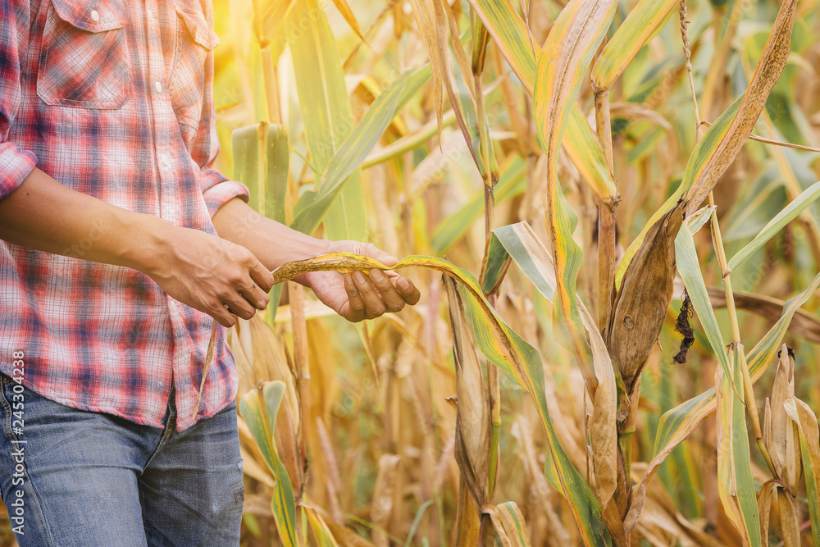
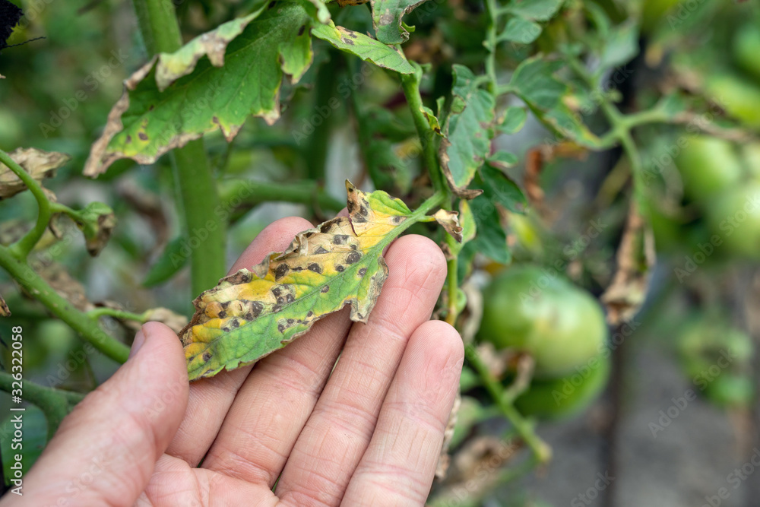
Limitations of Existing Work
Detection of small biological objects (about 2mm) over a big farm area is a challenge.
Traditional way of identifying and confirming such diseases is by visual observations from time to time (weekly/daily) which is difficult and not accurate.
Capturing images and detecting pests and diseases in real time is not yet implemented on full scale.

Slide 6
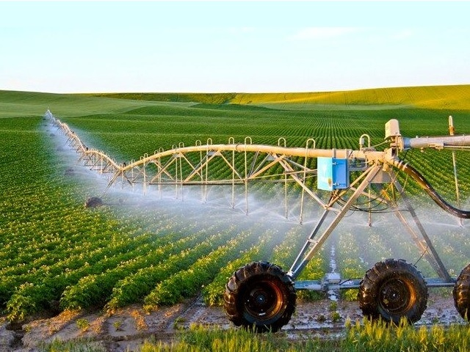
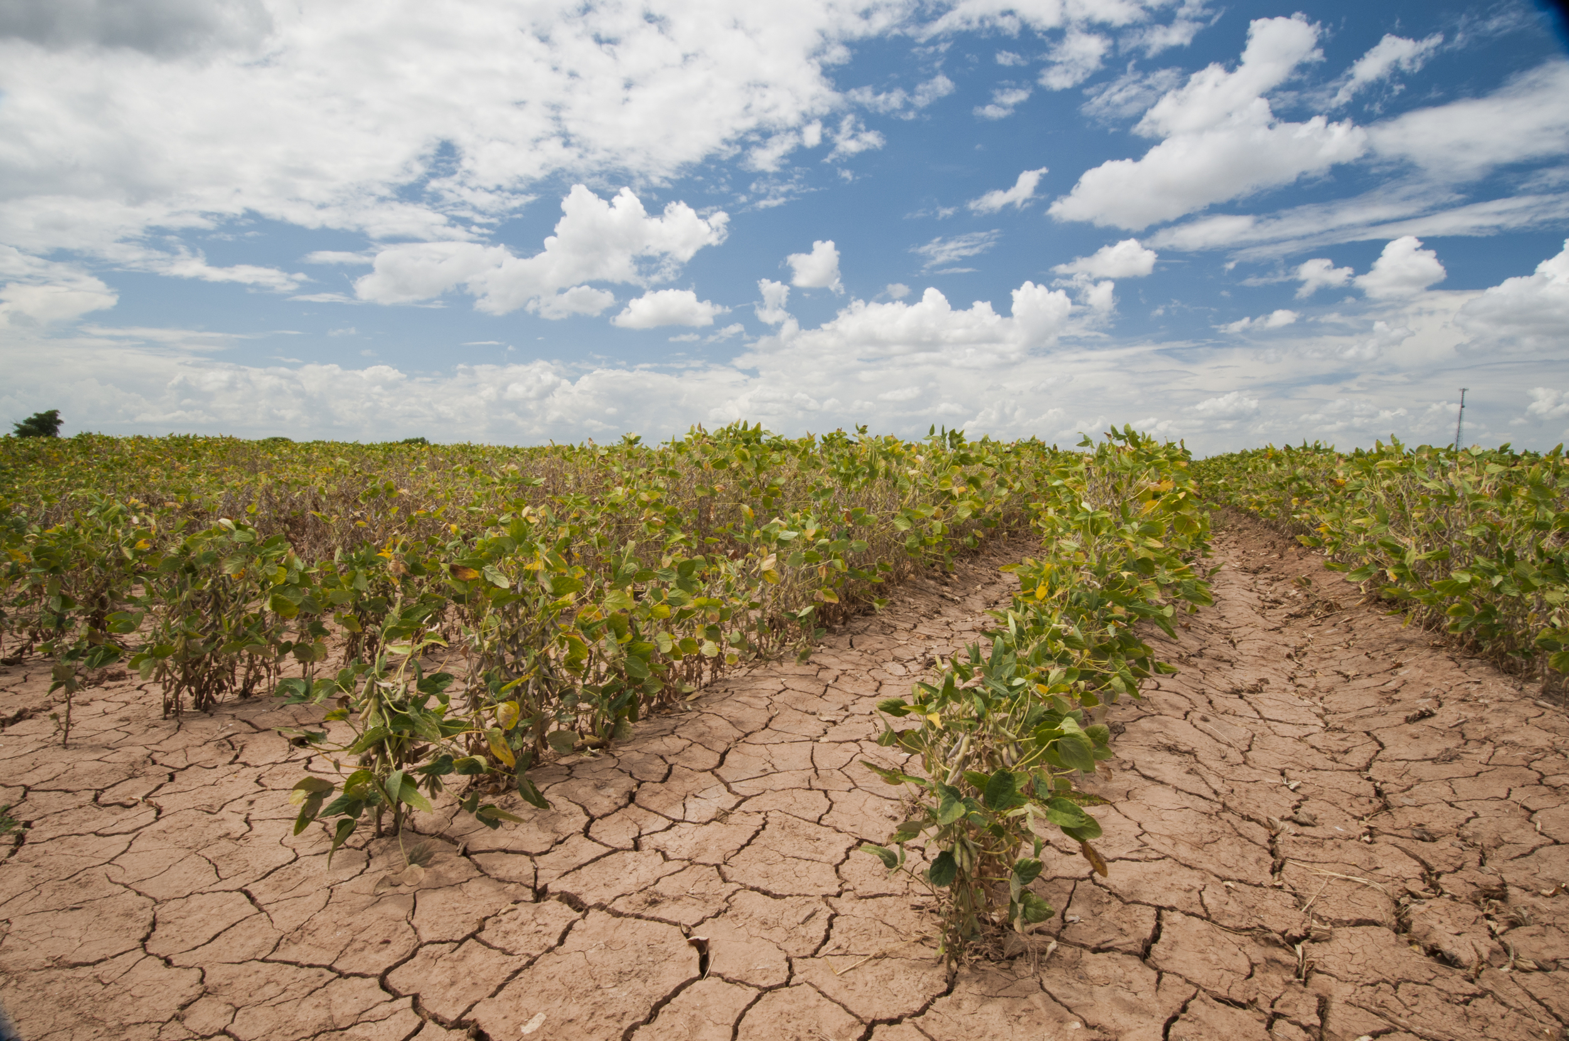
Problem Statement
To maintain crop health, prevention of crop losses is necessary. In this era of modern agriculture, we are facing the problem of different pests and diseases. To overcome this we are introducing some farmer friendly applications, for getting real-time diagnosis.

Slide 7
Objectives
To create an android application which work remotely as interface for farmers to upload images of infected plants.
To create a website through which professors/researchers can upload their images as well as they can monitor and sort those images.
To predict disease and pest, if any on the plant.
Creating one-to-one communication feature for real time diagnosis.

Slide 8
Main Module

Slide 9
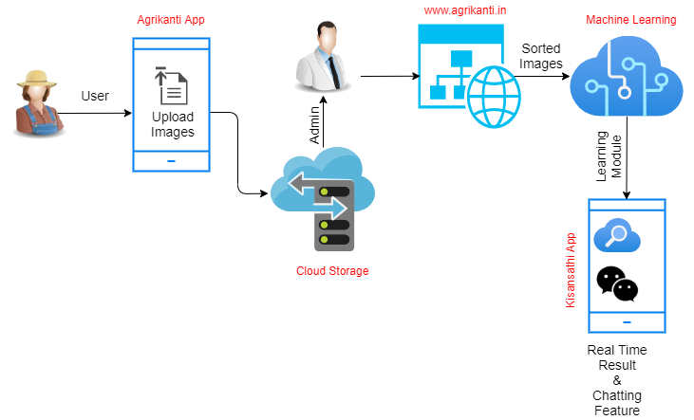

Slide 10
Agrikanti Application

Slide 11
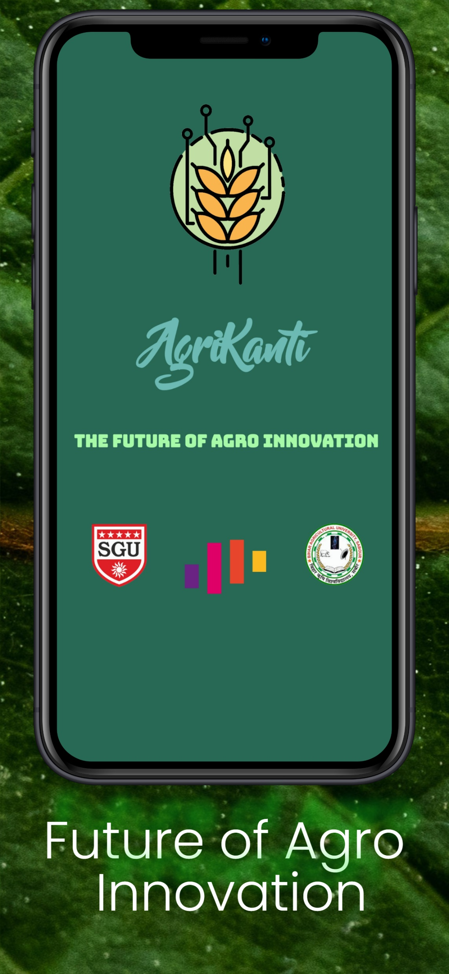
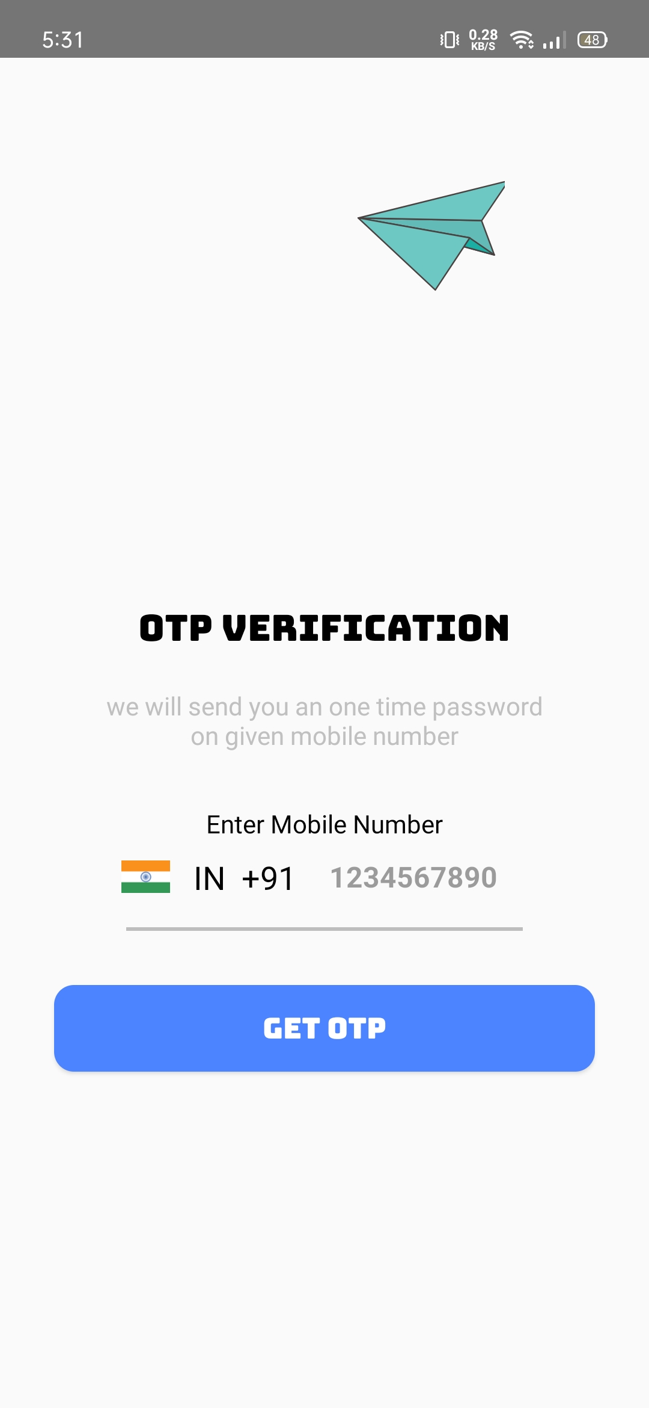
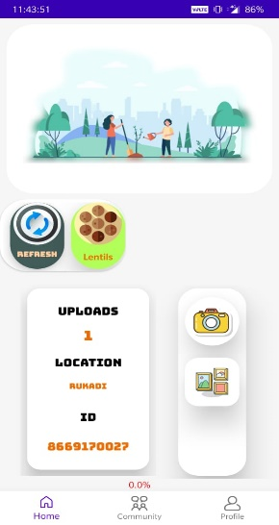
Choose crop type
Upload image from camera
Realtime-stats
Upload image from gallery
img1: Agrikanti App
img2: Authentication Feature
img3: Main Features
of App

Slide 12
“www.Agrikanti.in” Web Application

Slide 13
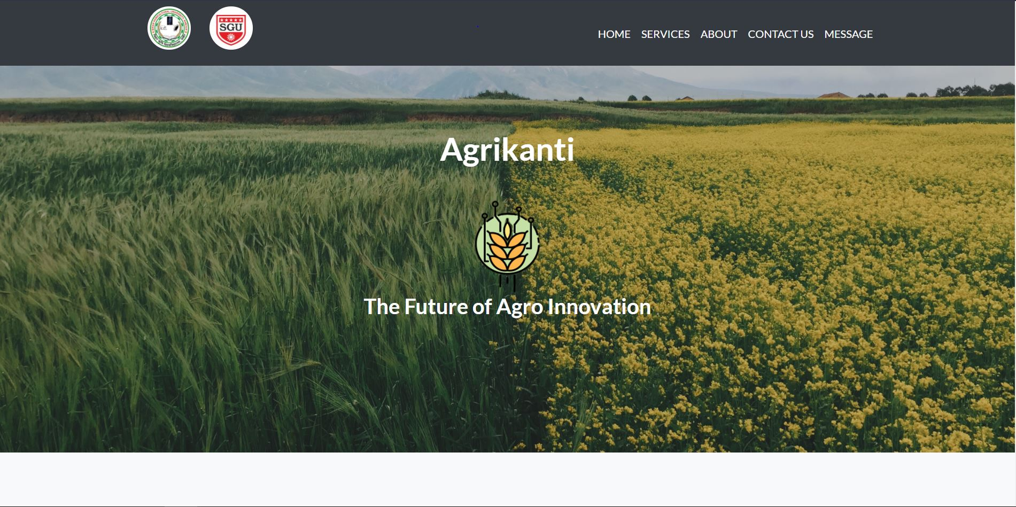
img1: Homepage

Slide 14
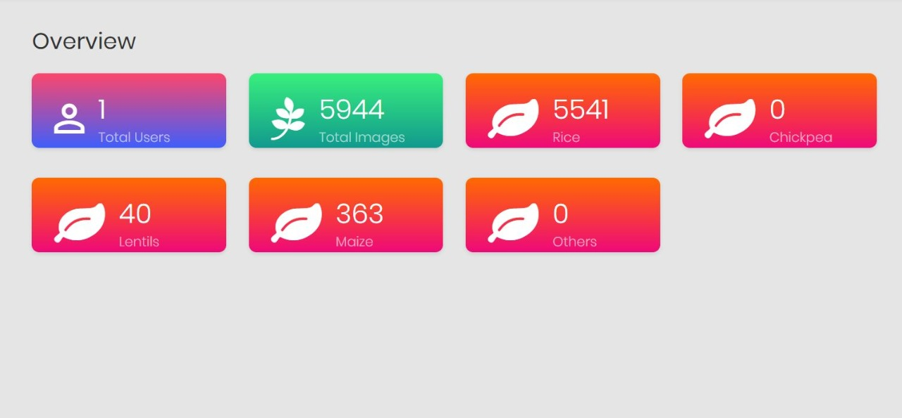
img2: Website Dashboard

Slide 15
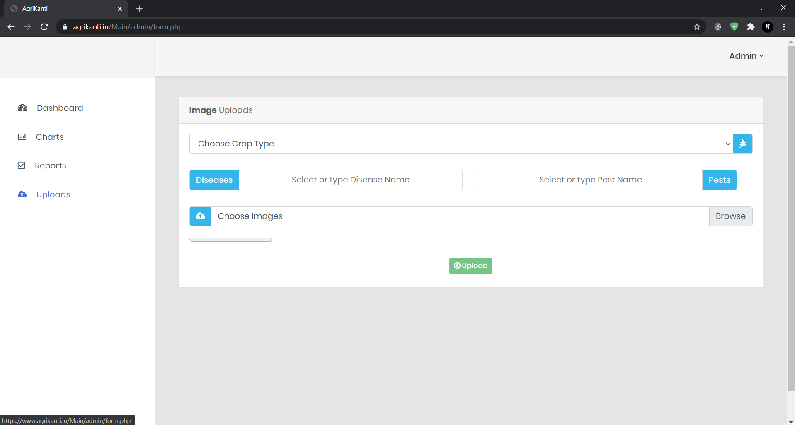
img3: Upload images through PC

Slide 16
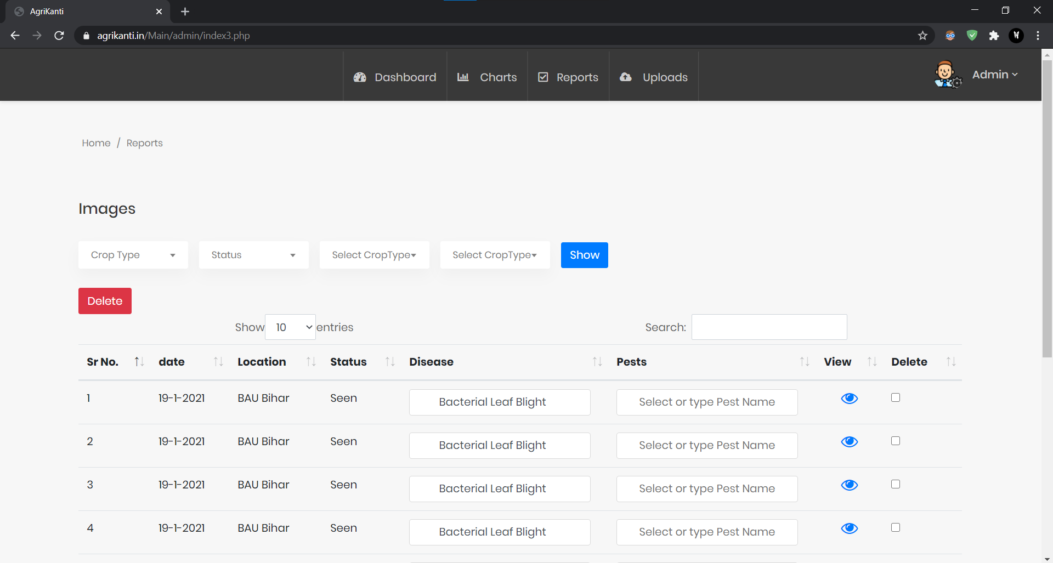
img4: Page to view the images uploaded

Slide 17
Machine Learning
InceptionResNet is used for transfer learning.
The model was trained on ml.g4dn.xlarge AWS instance.
Images in dataset is square fitted to 299x299.
Data Augmentation is done by rescaling, shearing, zooming and horizontal flip.
Trained on total 100 epochs and got accuracy about 0.97 with loss about 1.09%. Similarly, for maize pest accuracy is nearly about 98-99% with 0.05% loss.
checkpoint is used to save best value of loss and accuracy.
'Adam' optimizer is used and 'categorical cross entropy' loss function is used.
Trained model saved in ‘.h5’ hdf5 file which is converted into optimized .tflite model for deployment purpose.

Slide 18
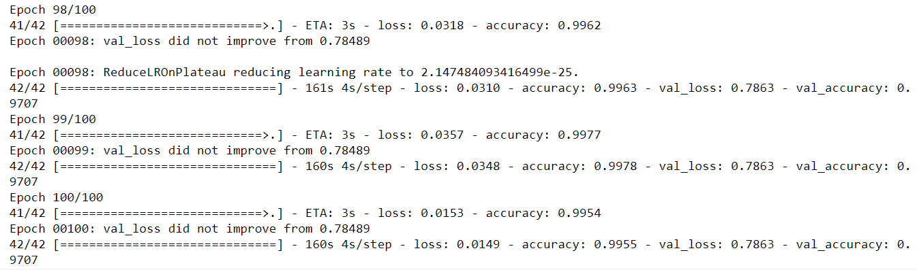
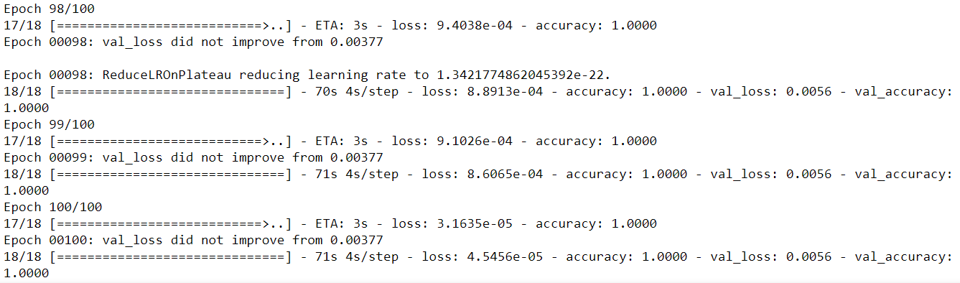
FIG: Represents final epochs of rice pest model
FIG: Represents final epochs of maize pest model

Slide 19
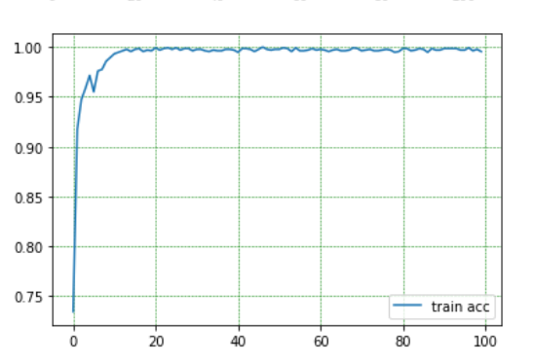
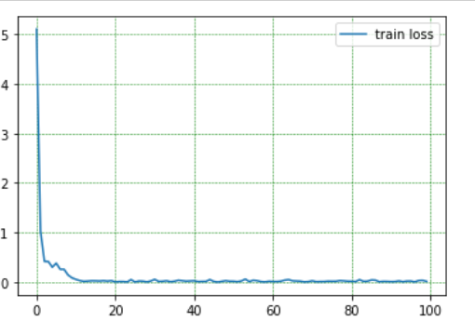
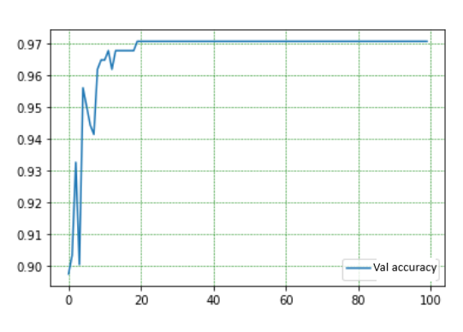
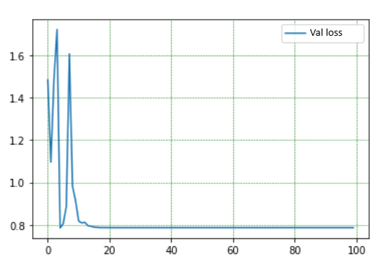
Fig: Represents performance of rice pest model

Slide 20
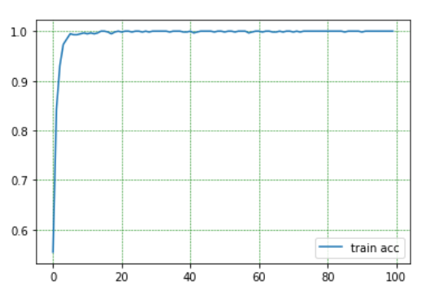
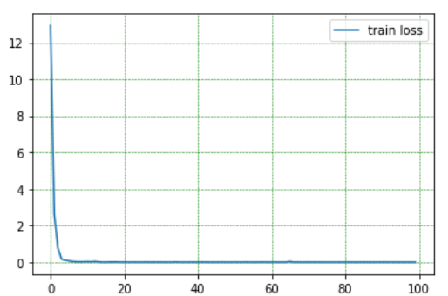
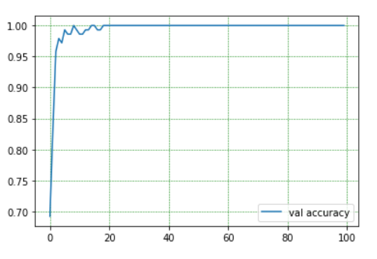
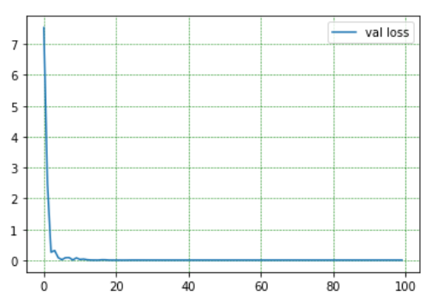
Fig: Represents performance of maize pest model

Slide 21
Kisansathi Application

Slide 22
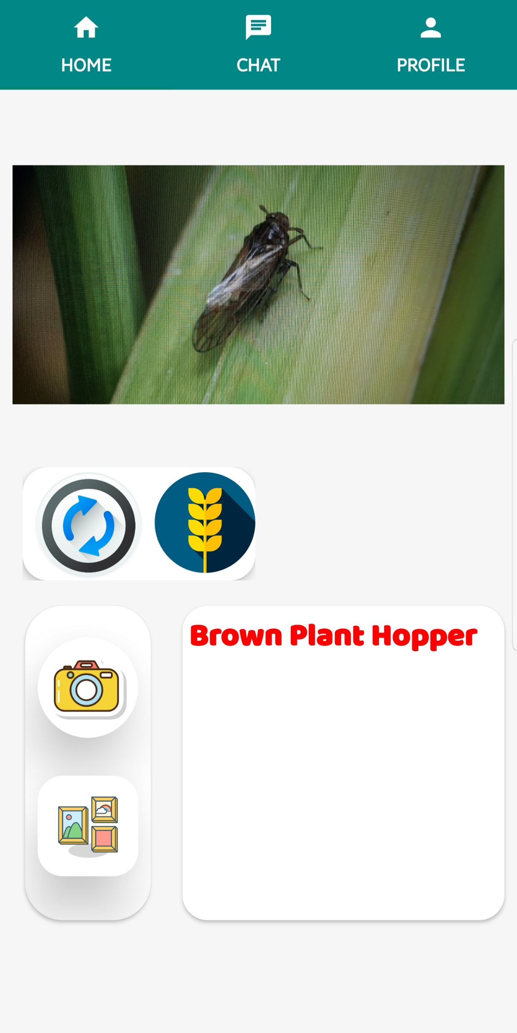
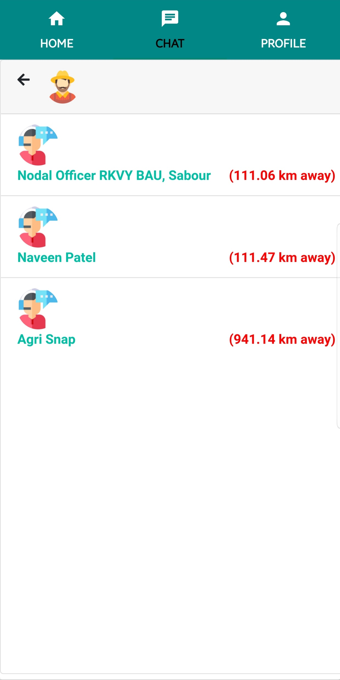
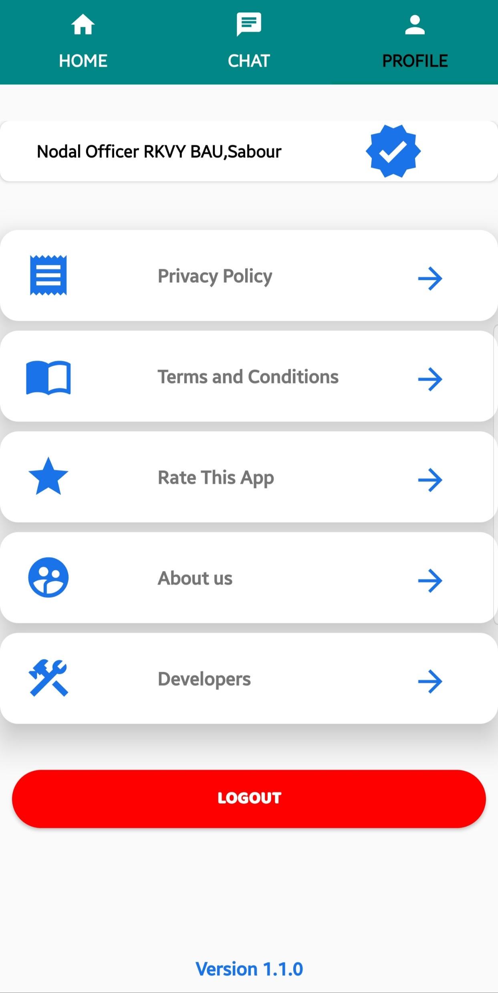
img1: Detection
img2: Chatting
img3: Profile

Slide 23
System Architecture

Slide 24
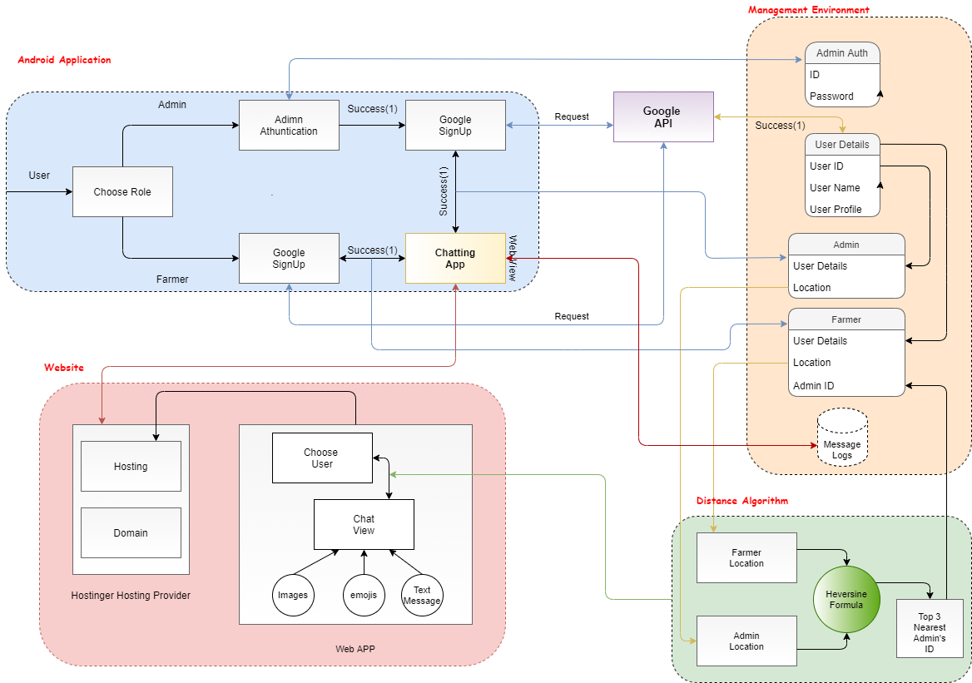
Fig : System Architecture for Kisansathi

Slide 25
Result Analysis
‘Agrikanti’ application is published and users started using it by uploading images of various infected crops.
An Agrikanti website is hosted and live therefore, admins can upload their images, monitor all data and sort images accordingly.
Sorted and useful data further got trained under Machine Learning.
‘Kisansathi’ app uses that ML trained data for real time experience.
‘Kisansathi’ is integrated with various feature, real time communication is one of them.

Slide 26
Thank You!

